Slide 1
Solution Assessments
Rufat Azizov
Solution Assessment Lead | Microsoft Azerbaijan | Belarus
Mobile: +994 50 291 79 80| e-mail: a-ruaziz@microsoft.com

Slide 2
FY20 Solution Assessments
GDPR
Contract Optimization
Helps customer understand their current readiness for GDPR and the necessary steps toward improvement.
Teams
Helps customers understand their Microsoft contract, licensing position and optimize related investments.
(11/1/2019) Support’s customer’s cross-team collaboration with Microsoft Teams
Workplace Modernization
How can I manage my cloud spending?
Focuses on migrating to or implementing a software as a Service (SaaS) Strategy.
Am I safe?
What can I migrate now?
How can we work better together?
Am I GDPR compliant?
Solution Assessments
Keep the Customer at the Center of our Cloud
solutions
Is this contract best?
(11/1/2019) Manages cloud spending to improve financial governance customer’s Azure solutions
Takes a comprehensive look at customers’ cybersecurity infrastructure.
Azure Cost Control
Cybersecurity
How do we migrate SAP?
How do I move to the cloud?
How to I transition my servers?
(11/1/2019) Gives customers a strategic plan to migrate mission-critical SAP systems to Azure.
How much will it cost to move?
Helps customers access and prioritize their current server workloads and applications.
SAP on Azure
Infrastructure Optimization
Provides customers with no current Cloud deployments a comprehensive Assessment of their IT estate.
Lets customers get the most out of their server and data center investments.
Cloud Economics
Data Optimization

Slide 3
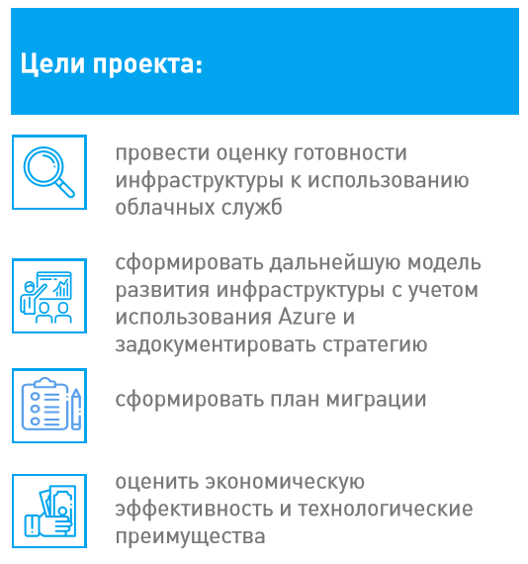
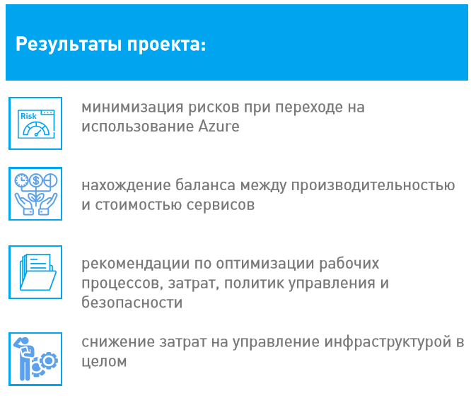
Процесс перехода на использование сервисов Azure не прост, он затрагивает всех людей в компании, ее бизнес-процессы и технологии. Прежде чем начать такой проект требуется определить стратегию и сформировать стандарты, разработать план миграции, спрогнозировать затраты на поддержание инфраструктуры в Azure, найти баланс между производительностью и стоимостью, проработать аспекты безопасности, грамотно перенести рабочие нагрузки, повысить квалификацию сотрудников, вовлеченных в поддержку сервисов.
Solution Assessments

